Slide 1
THE 2007 ESTONIA CYBERATTACK
Bustarde, Jhon Angelo
Cortez, Maylene
Holgado, Ruven Jude
Lontok, Timothy
Padernal, Jevi Kent
Rastrullo, Mark
Sumague, Von Ryan

Slide 2
2007
01
02
03
APRIL 27
WEEK
WEEK
WEEK
May 18
A three-week battle between Estonia and a cyberattack on the Estonian Internet infrastructure, which was subjected to a Distributed Denial of Service (DDoS).

Slide 3
What is a Distributed Denial of Service (DDoS)?
It is one of the most popular types of cyberattack.
A DDoS attack is a malicious attempt to interrupt regular traffic to a targeted server, service, or network by flooding the target or its surrounding infrastructure with Internet traffic.
ERROR
NO ACCESS

Slide 4
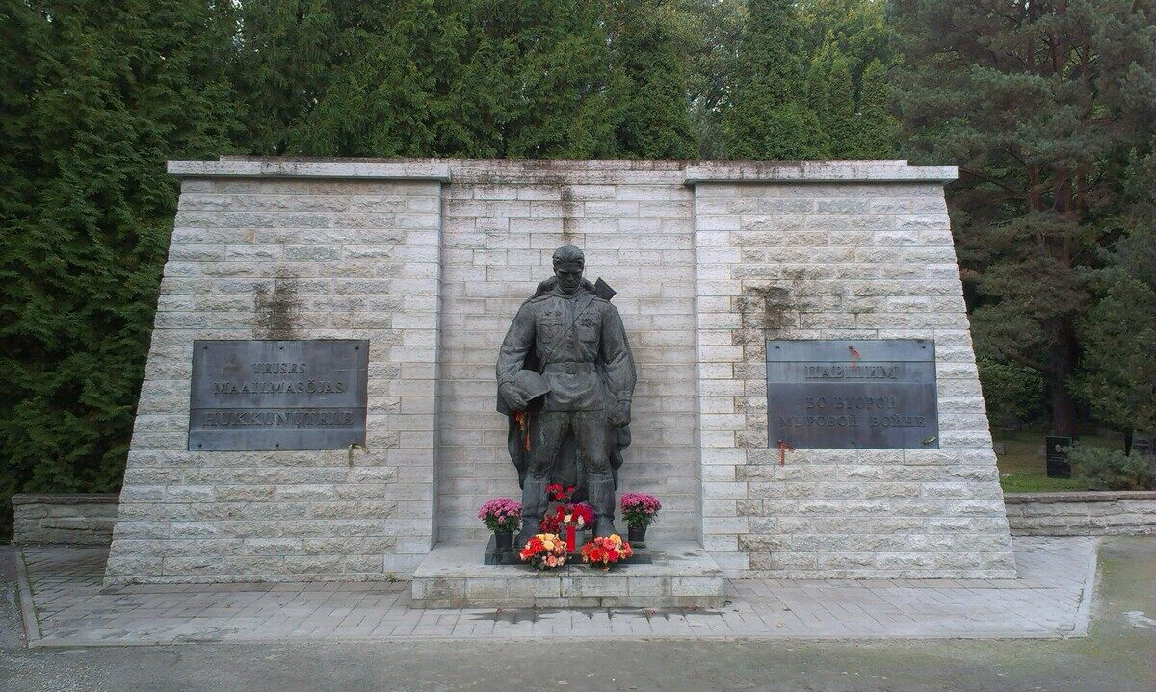
Why did the attack happened?
The Estonian government was thinking of moving the Bronze Soldier of Tallinn, a Soviet World War II memorial, from its current location to the Tallinn Military Cemetery. The decision became a flashpoint for Estonian citizens, and Russian-Estonian relationships were strained as the number of rallies and counter-protests swelled.

Slide 5
THE TWO PHASES OF THE ATTACK

Slide 6
First Phase
1
Estonian enterprises were subjected to a variety of attacks on their servers, which were used for e-mail, the Web, domain name resolution, and other Internet services. Under abnormally heavy data traffic, systems slowed or stopped. Web defacement occurred on several websites. Even more spam and fraudulent emails arrived in inboxes.

Slide 7
Second Phase
2
The coordination of the attacks in the second and major attack phase no longer relied on forum communication and synchronized human activities. This phase began on April 30 and ended on May 18, 2007.

Slide 8
Waves of Second Phase
Featured DDoS attacks on websites and DNS services on May 4. The first week of May was quite uneventful.
Featured DDoS attacks mostly on government websites and financial services on May 9-11.
Featured botnet-based DDoS attacks targeting government websites and the financial industry on May 15.
Consisted of attacks on government websites and banks once more.
1st Wave
2nd Wave
3rd Wave
4th Wave

Slide 9
This event is widely regarded as the first major act of cyberwarfare in the world.

Slide 10
How is it prevented?

Slide 11
Mental readiness to accept the possibility of a Cyberattack
The Estonian intelligence agencies had briefed the government about the likelihood of cyber assaults not long earlier. This was in relation to the dangers of electronic voting. However, this supplied the mental readiness required to recognize the possibility of an attack.
33%

Slide 12
Cooperation with the Private Sector and International Collaboration
It would have been impossible to block the attacks and respond to them as a group if the state had not just inked a cooperation agreement with some of Estonia's largest private sector firm, and if not because of the urgent response of their own Computer Emergency Response Team (CERT), its European equivalent, NATO CERTs.
66%

Slide 13
Being public about the issues
Being public spared the government of the need to come up with fictitious reasons for what was going on. It established the required foundation of trust between the state and its citizens. While it appeared to be a major setback for Estonia's status as an e-tiger, it really marked the beginning of a new chapter in the country's success narrative by placing Estonia as a thought leader in cyber security.
99%

Slide 14
It took almost two years for Sergei Markov, a Russian State Duma deputy, to identify the perpetrators of the attacks as members of the Nashi youth club, a state-affiliated organization. Members of Nashi say that the assaults were carried out without the help of Nashi or the state, but the veracity of those assertions is impossible to establish.

Slide 15
Do we agree with the resolution of the Estonian government?
Our group agrees. Estonian government authorities concentrated on the attacks (such as attempting to trace individual IP addresses). Estonia was able to not only work locally, but also seek out to partners and other countries for assistance. It serves as a model for other governments on how to cope with a big cyber incident.

Slide 16
Conclusion and Recommendation
The current state of cyber threats is becoming more diversified and complicated as a result of technology advancements and a deteriorating worldwide security environment.
The government should develop intrusion detection and protection systems, collaborate with both public and private organizations, greatly contribute to user awareness, and engage in active international collaboration to possibly avoid and be ready in case a cyberattack happens.

Slide 17
Thank You!
Any question?
Presented by:
BSIT 4-1 (Group 3)
Presented to:
Mr. Jason Peñalosa
Information Assurance and Security 2, Professor

